Slide 1
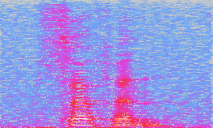
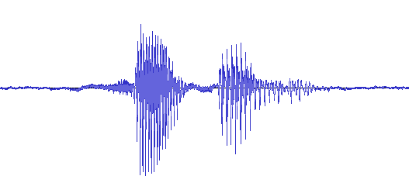

Problem Statement
Unsupervised audio generation
Generative adversarial networks (GANs)

Slide 2
Applications
Music production
Text-to-speech
Data augmentation
Sound design

